Slide 1
ASRTOLOGY PREDICTION SYSTEM

Slide 2
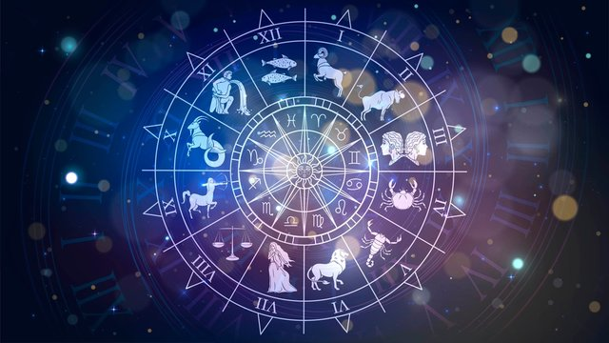
PROJECT-47
TEAM MEMBERS
A.ANANDA VARSHA 2200030100
CH.JYOTSHNA 2200032739

Slide 3
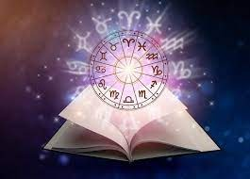
INTRODUCTION
Astrology, which derives from the Greek word astrologia (αστρολογία), is the study of heavenly bodies in an attempt to explain and understand the mysterious and complex relationship between the Universe as a whole and human beings. Historically, there are a variety of different forms of astrology, with the first documented evidence of Western and Near East Astrology coming from Ancient Mesopotamia (around 2000 BCE), and astrological systems being developed independently in Ancient China, Mesoamerica, and India. While modern-day astrology primarily focuses on individual-level predictions (what we think of as “horoscopes”), astrologers in ancient time often took a more “big picture” focus as they attempted to use the stars to divine the will of the gods for all of humanity.

Slide 4
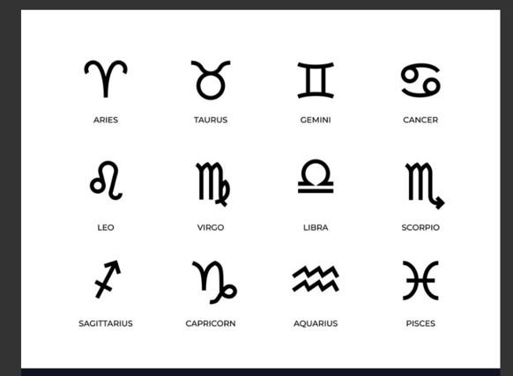

Slide 5
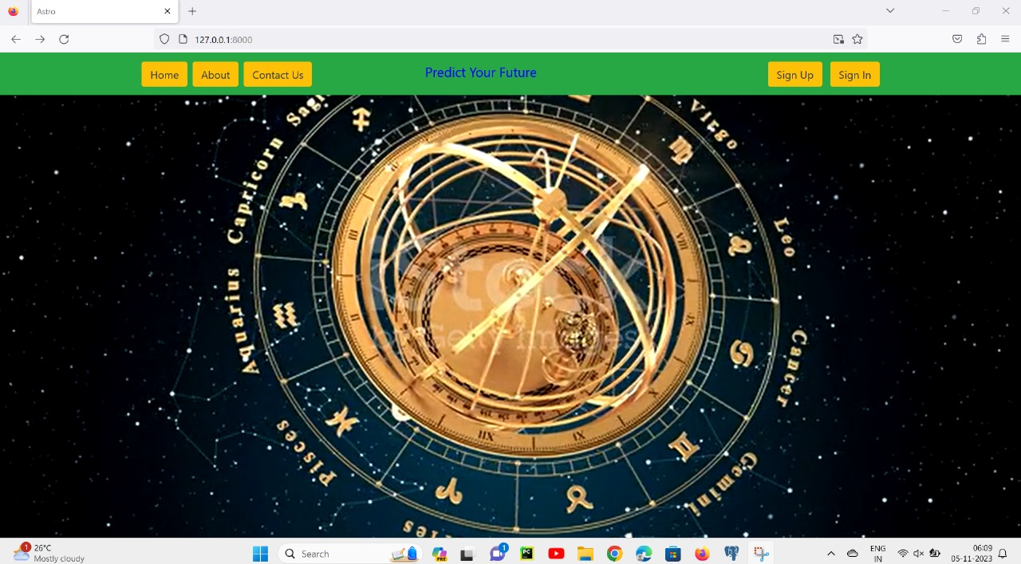

Slide 6
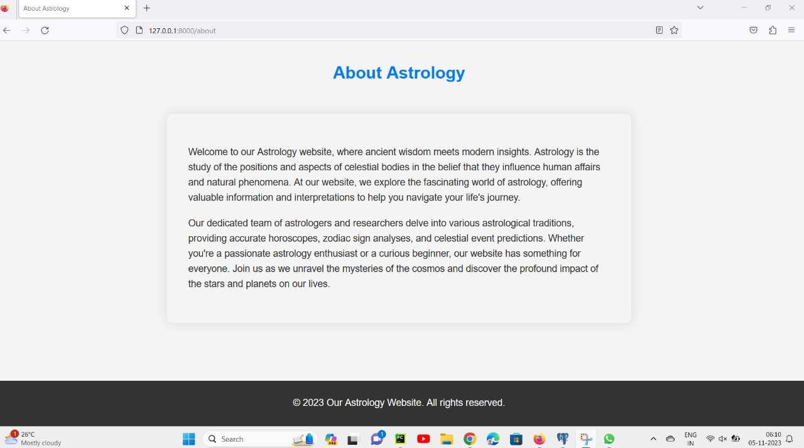

Slide 7
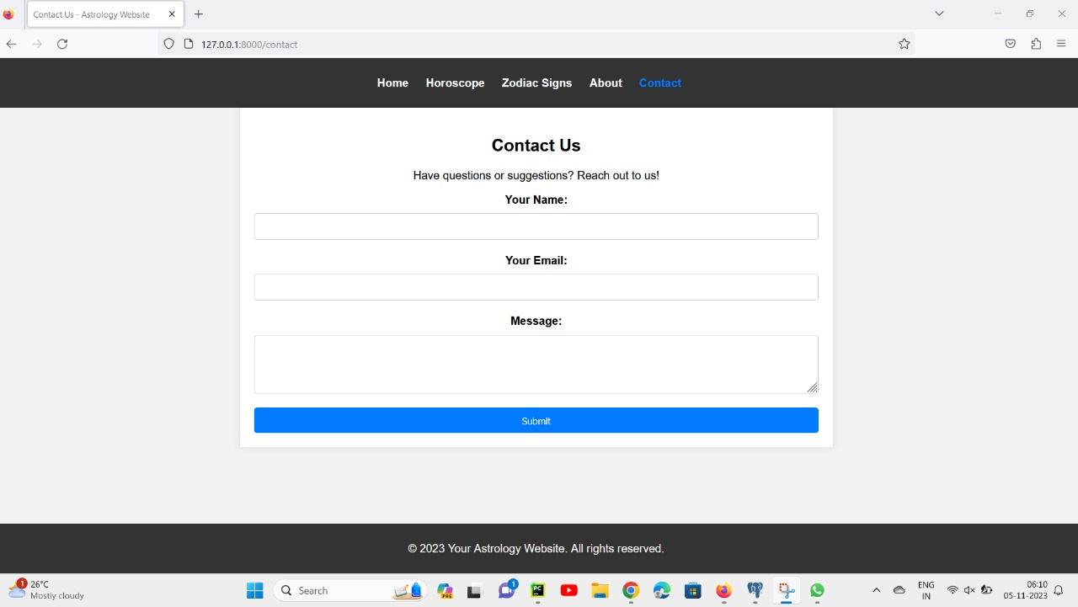

Slide 8
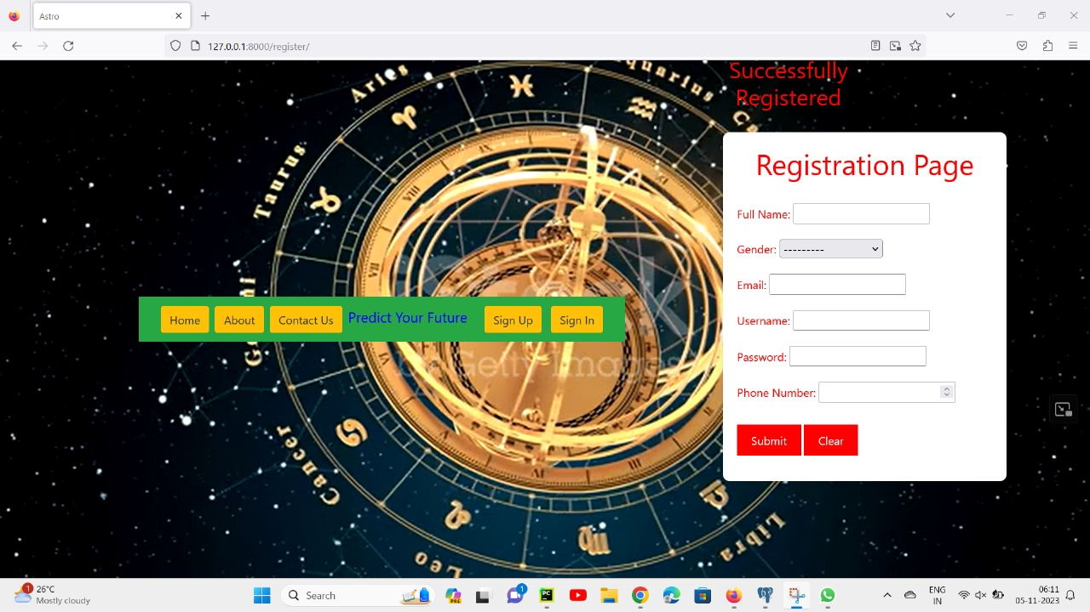

Slide 9
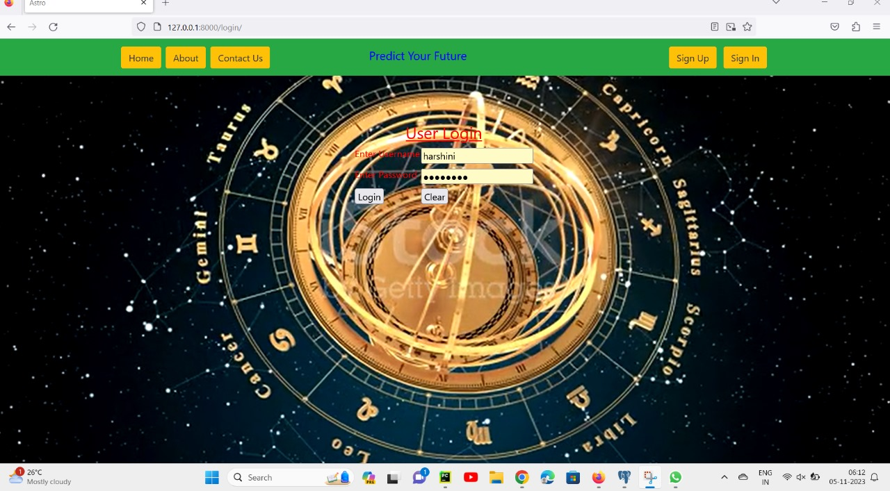

Slide 10
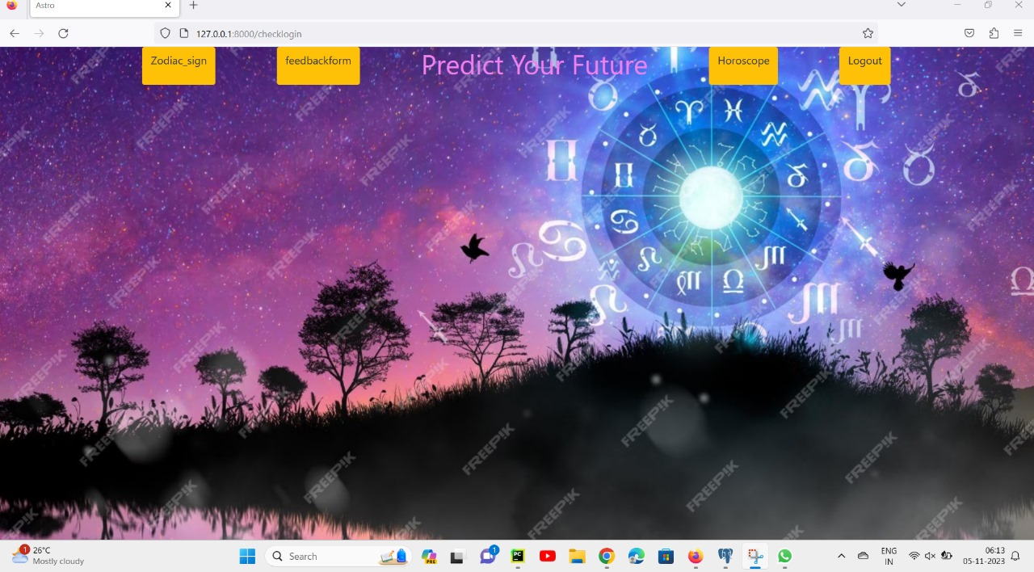

Slide 11
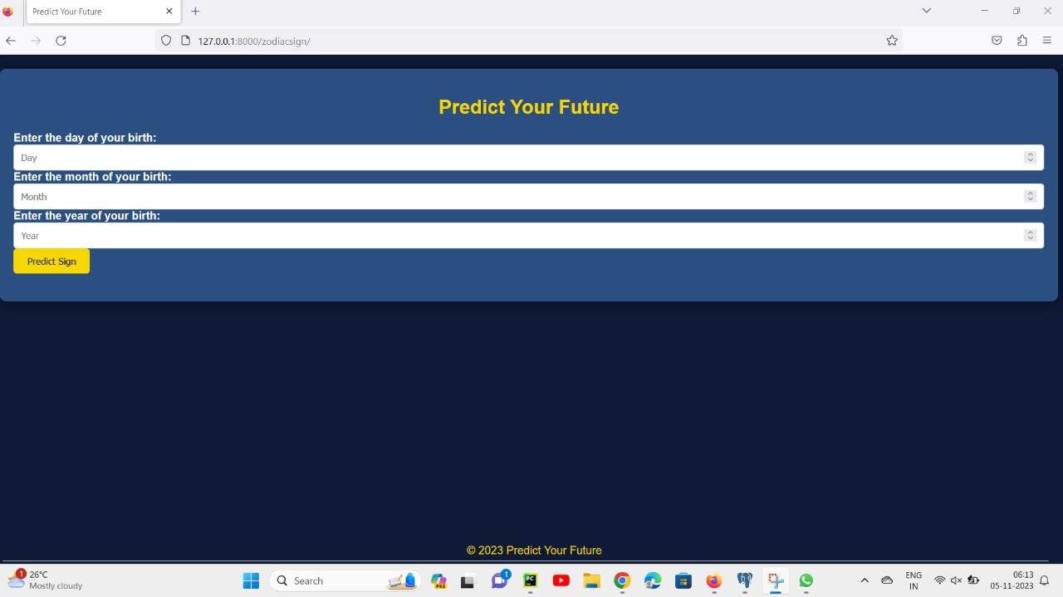

Slide 12
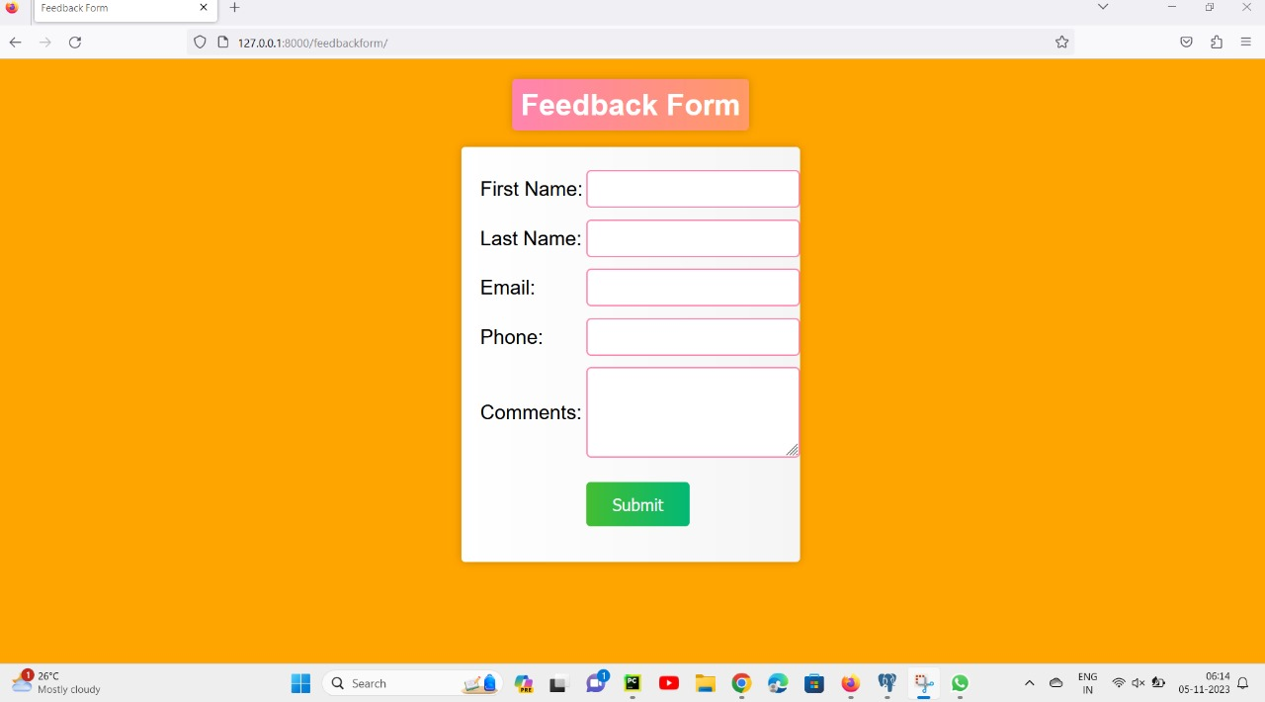

Slide 13
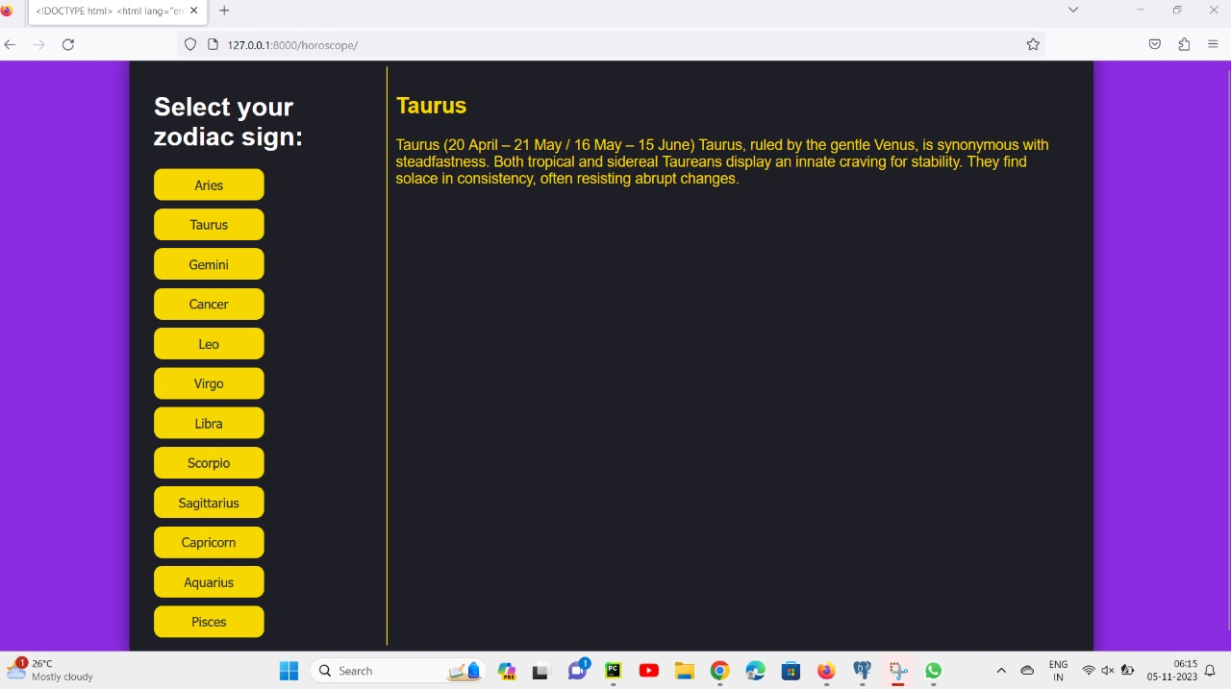

Slide 14
USER STORIES:-
1. "As a curious individual, I want to delve into astrology to gain insight into my life's purpose and make informed decisions about my future."
2. "As a believer in astrology, I want to use my astrological birth chart to enhance self-awareness and personal growth."
3. "As a parent, I want to explore astrology to better understand my child's unique qualities and provide them with the support they need."
4. "As a person going through a challenging time, I want to explore astrology to find guidance and reassurance during difficult moments."

Slide 15
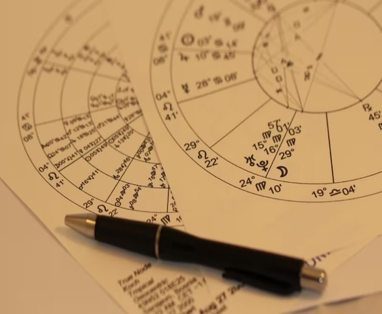
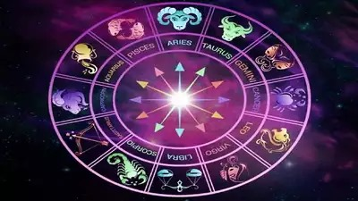

Slide 16
CONCLUSION:
In conclusion, the astrology prediction system is a fascinating and innovative endeavor that combines the ancient art of astrology with modern technology. Throughout the development of this project, various aspects of astrology, such as zodiac signs, planetary positions, and astrological calculations, have been translated into code to provide users with personalized predictions and insights.This project showcases the powerful capabilities of Python programming in the realm of astrology, enabling users to access astrological information conveniently and efficiently. By leveraging libraries and APIs related to astrology, the project has successfully bridged the gap between traditional wisdom and contemporary programming techniques.

Slide 17


